Slide 1
Academic Career Development November / December 2018
edgehill.ac.uk
Notes:
Welcome
Introductions

Slide 2
Background
Commitments within Athena SWAN Bronze bid (2014)
ACD Working Group established to consider
Academic progression and promotion pathways
Standardised job descriptions
Accelerated progression processes
Flexible working practices
Academic workload
Benchmark against good practice in sector
12 recommendations approved by the Academic Board in June 2017
Notes:
Between 2014 – now ACDW – set of recommendations based on themes emerging from the gap analysis
Historical focus on R
Confusingly similar
Acc prog – different process in 3 faculties
FWP – e.g. hinder career development opportunities for women
Workload – uneven practice across uni
Start to think less college more modern university / mirroring best practice out in the sector

Slide 3
What is changing?
A refined academic career structure fit for the future
The title ‘Reader’ will denote a substantive grade 11 post, in line with sector norms, i.e., not fixed term
Appropriate recognition for contribution in either R, T&L or E by means of the titles Reader, Senior L&T Fellow or Senior Enterprise Fellow permanently awarded in annual promotion rounds (or advertised posts)
Opportunities for accelerated progression, so career advancement is considered at any point of an academic’s career
Applications for progression will be considered and verified by a University-wide panel rather than solely by the Faculty Dean
Notes:
Mirrors the same basic hierarchy utilised in other modern Universities.
the title Reader will no longer be bestowed on academics at any stage of their career. Current any grade 8-11 +2 increments / FTC 2 years
Opening up 3 career pathways R/T&L/E – a pathway
started this year

Slide 4
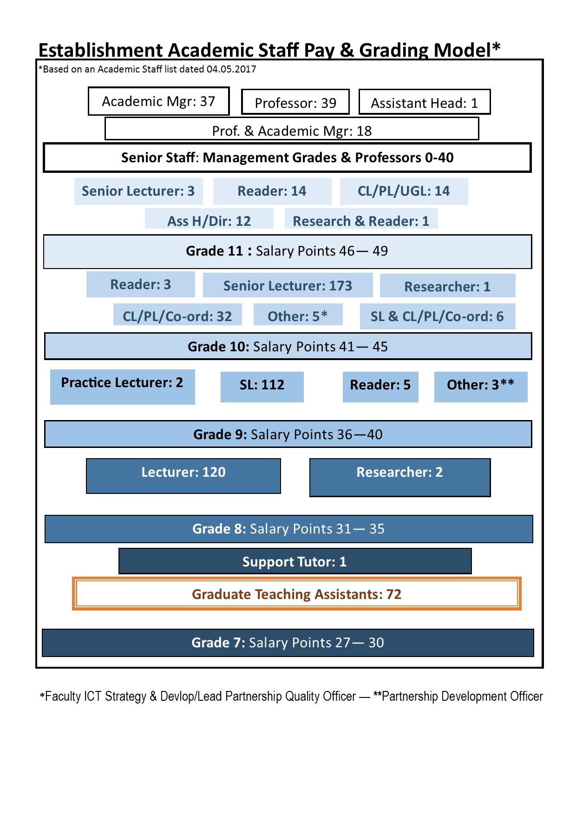
Current Academic Structure
Notes:
Ultimately Edge Hill wants to be able to attract and retain an excellent academic workforce through a modern and flexible approach to academic career development, so it can build the workforce profile needed in 2020.
Whatever your passion is as an academic, we want to make sure you have the opportunity to pursue it here at Edge Hill University. To do that, we need to make sure there is a career structure in place that is easy to navigate (current structure doesn’t quite fit that description!) and where there is parity of esteem between the different routes for progression, be it teaching and learning, research or enterprise
So, if pedagogy is your greatest passion, there is a teaching and learning progression route that enables promotion to Professor.
These changes provide a genuine opportunity to enhance career advancement and speedier progression and recognition via merit awards which is not currently in place.
You can see that there will be fewer titles within the refined academic career structure and individuals will be assimilated into the revised roles by the start of the Academic year 2020. Assimilations will be straight forward in the majority of cases, but where anomalies lie – individuals will be contacted and consulted with way in advance.

Slide 5
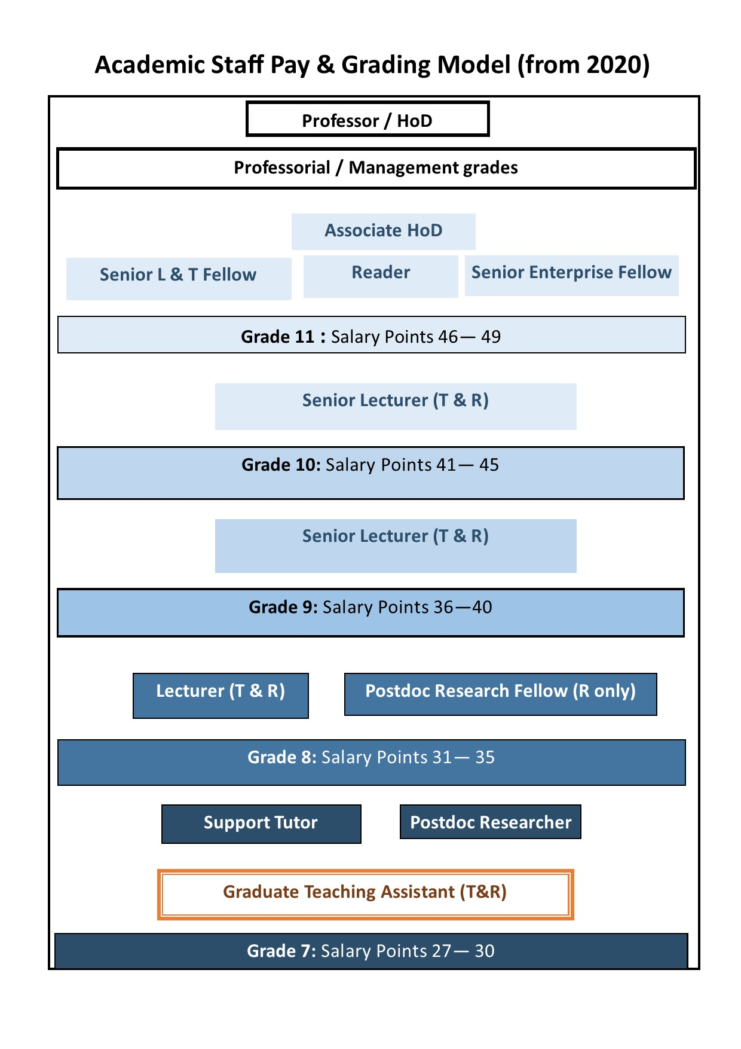
Refined Academic Structure
Notes:
There will be appropriate recognition for relatively senior staff making a significant contribution in either R, T&L or E by means of the titles Reader, Senior L&T Fellow or Senior Enterprise Fellow permanently awarded in annual promotion rounds (or advertised posts). These 3 roles will all be Grade 11 posts
Up to Grade 11 when the career pathways become very distinct there will be an expectation that lecturers / practitioners will undertake a full remit of each JD
Merit awards.

Slide 6
What’s the plan?
Changes will be introduced over the next two years
Refined academic career structure in place by the start of the academic year 2020
Those on fixed term Reader’s contracts currently will continue to run until their expiry in 2020
The focus over the current academic year 2018/19 is to make the much-needed improvements to the progression process for Lecturers and Senior Lecturers.
Review of job descriptions and provide more clarity on the criteria for progression
Enhance the support available to academic staff and managers to assist with career development planning
Increased awareness of the various career pathways and routes for progression
There will be a call for Progression and Professorial applications in Spring 2019 (possibly as early as February 2019).
Notes:
Lots of activity happening to raise awareness of the changes, these roadshows and pop up information stands, line manager training in the new year – later part of January
*e-enabling process – so we can capture important data etc

Slide 7
Questions?
Notes:
Stonefish
Questions
Assimilations – unique cases = consultation
MGT Cases – won’t form part of panel deliberations, but can take place at point of need. P&PR rounds = individual applications only
Development Discussions – PR = short term 12 month / operational. Devel Plans – aspirational / long term / 2 way & joint obligation to pursue, set up / gap analysis – chose trajectory and mirror development with it. Talent module will provide assistance & templates.
Feedback – 5 areas (all scored) R, T&L, SS, Admin & external networking, liaison etc, other – enhancing developmental discussions / plans
EHU – obligation to moderate application process – doing so now using an objective cross university panel rather than 3 separate panels within each faculty
Programme Leader – just 1 isolated criteria and aspect of a full JD – undertaking PL duties does not automatically entitle an individual to promotion to grade 11!
Job Descriptors? T&L, R & SS on WIKI – confusing information in past / streamlined in 2006/7 as part of Pay Framework exercise. 2 documents attached to each role on wiki – focus on the Research version as we don’t have T only contracts at EHU
Timeframes – Progression and call for Profs Spring/Feb (hopefully via Stonefish) Readers = Autumn 2019 Supportive Workshops for Managers / Ac Staff – Late January. Anyone can attend – encouraged to do so to support career development. PRs should be happening now – if not prompt, have a dedicated discussion
PhD essential for promotion to Grade 11 posts? What about experience? Individual cases, individual merits – not having a PhD wouldn’t necessarily disbar you
UCU communication to members – EHU in dialogue with UCU. UCU view is that if you’re willing and able to undertake G9-10 it should be an automatic progression. EHU position is that an application has always been in place – pay framework 2006 dictates that there is a moderation process in place and no financial barriers
Promotion Vs Progression – different language used in the sector which can be confusing. EHU = Promotion – application to Reader / Prof. Progression – upward movement between grades 8-9-10 – individual application.
Accelerated Progression – management led business case – will sit outside the panel process and can happen at any time.
Can HR attend IDP / PR discussions for individuals – no. too formal – must be a 2 way dialogue with Line Manager, HR won’t interfere
Salary Start Point when successful? Usually at the bottom of the new grade unless there’s special circumstances
Addressing Faculty inequities – slowly addressing anomalies. Faculties aligning resources to department strategy i.e. what they need to deliver

